Slide 1

EE Program Proposal
Alyssa Turner | FNR4070C

Slide 2
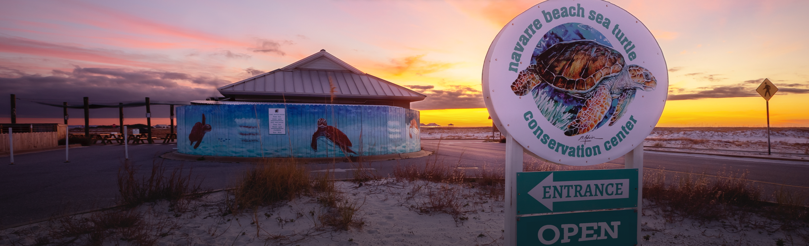
What is the NBSTCC?
Nonprofit located on Navarre Beach, Florida
Working conservation and education center open to the public
Vision:
  “To impress upon the community the importance of sea turtle conservation and the preservation of the world’s marine resources for the enjoyment of future generations.”

Slide 3
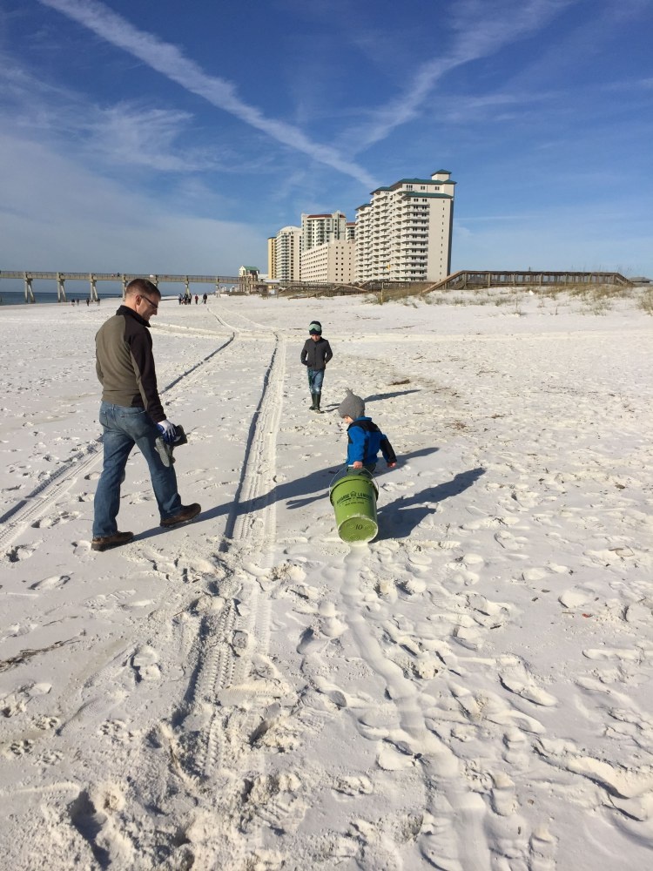
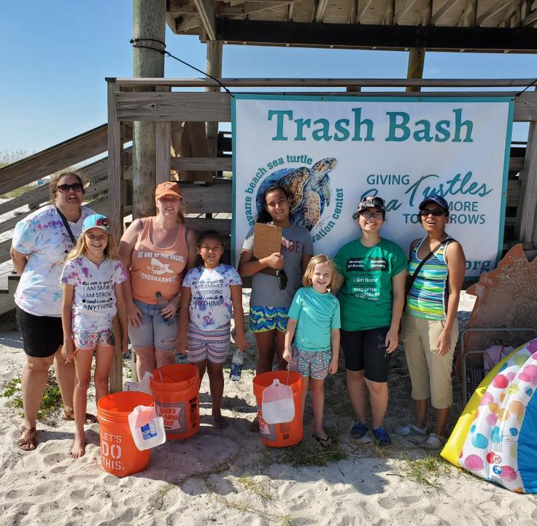
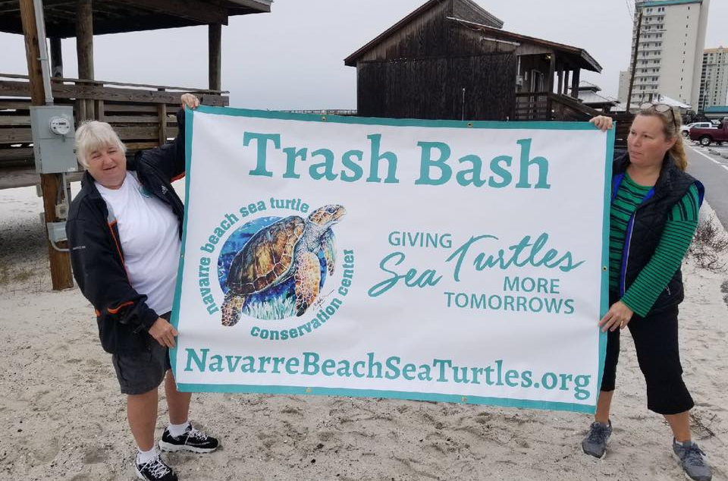
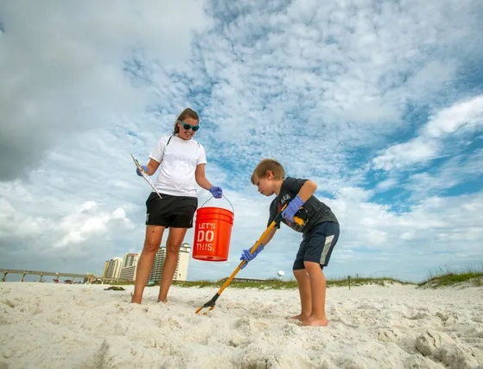
Trash Bash Program
Expansion of existing project
Navarre High School
  400 students reached
  Five months, 10 Trash Bashes
Half-day program
  Beach clean-up
  Curriculum focused on the effects of marine debris on ecological systems
One year program proposal
  May through April

Slide 4
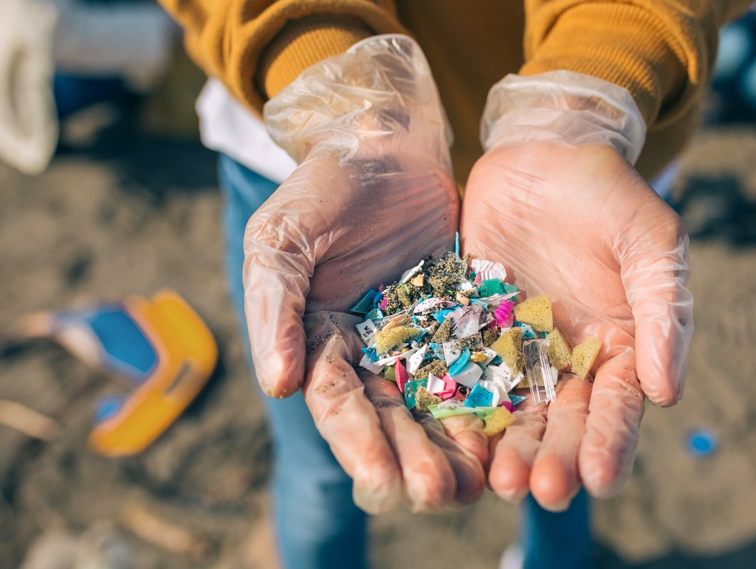
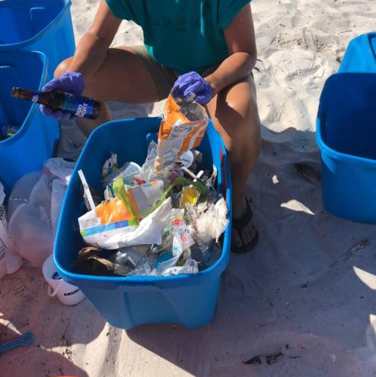
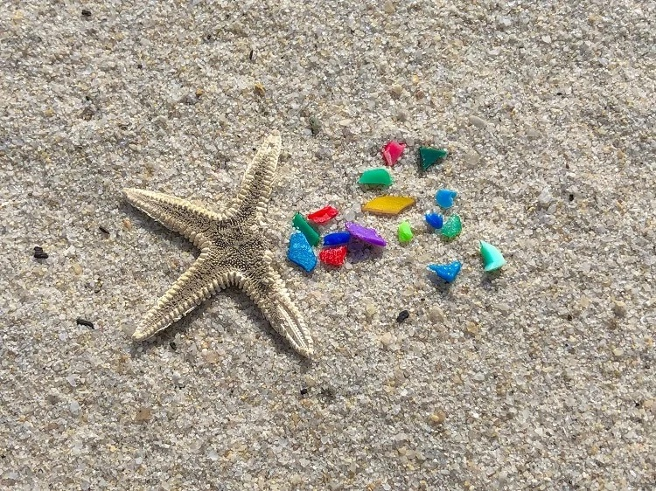
Why?
Marine debris is a constant issue
  Causes major impacts on environments
Meets NBSTCC’s goals
  Focuses on principles of conservation and education
  Simultaneously helps provide safer habitats for sea turtles in the area
Addresses interests of the funder
  EPA strategic priority
    Pollution prevention
  Educational opportunity
    Engaging in community-based issue education that results in improved environmental quality

Slide 5



Budget
Matching funds
  NBSTCC, Navarre HS, & Greg Jones Studio
Minimal equipment/supplies needed
  Transportation & salary compose bulk of request
Key staff
  Executive Director, Program Coordinator, & Intern
Requested Funds | $5,203.00
Matching Resources | $3,428.70
Total Budget | $8,631.70

Slide 6
Thank you!
Alyssa Turner | FNR4070C

