Slide 1


PUR 3801 | Alyssa Turner

Slide 2
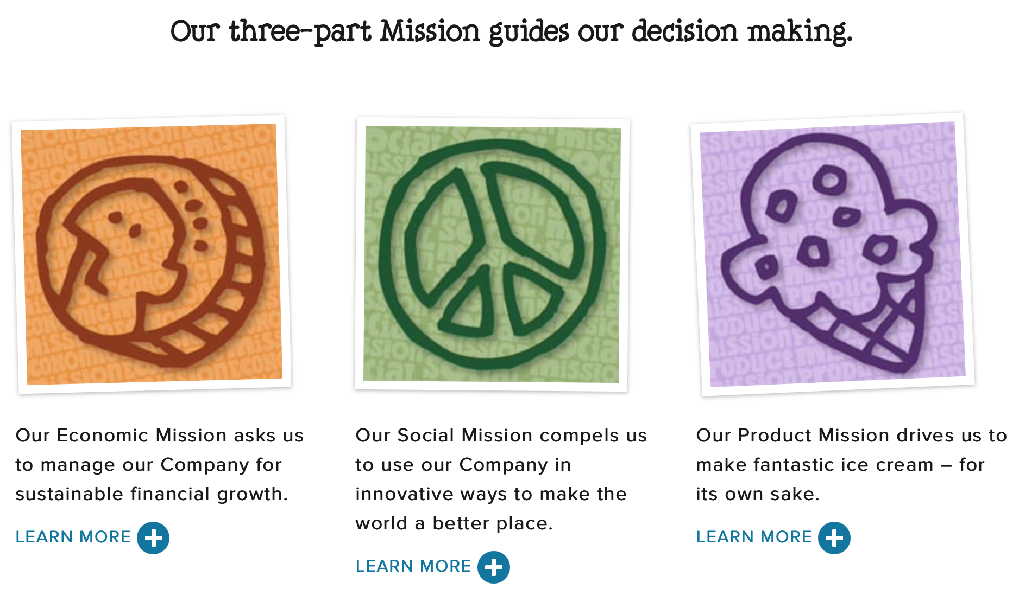
Mission Statement
“Ben & Jerry’s is founded on & dedicated to a sustainable corporate concept of linked prosperity. Our mission consists of 3 interrelated parts: Economic Mission, Social Mission, and Product Mission.”

Slide 3
Company Background
Founded in 1978 in Burlington, Vermont
  Ben Cohen and Jerry Greenfield founded the company after taking a $5 correspondence course on ice cream making from Pennsylvania State University and investing $12,000
In 1981, the first franchised scoop shop was opened in Shelburne, Vermont
The company became a wholly-owned subsidiary of Unilever, a British multinational consumer goods company, in 2000
The organization’s social missions have remained since 1989
  No rBGH; “Support Farm Aid” messaging; Children’s Defense Fund; “One Sweet Whirled” campaign; Rock the Vote; protest Alaskan oil drilling; Fair Trade Upgrade; rally against economic inequality; non-dairy products; etc.

Slide 4
Social Mission Timeline
Partnered with Greenpeace to win EPA approval of hydrofluorocarbon (HFC) free refrigeration cabinets
Began Carbon offsets with Native Energy for Vermont manufacturing facilities
Life Cycle Analysis complete for US
Life Cycle Analysis complete for EU
EU began carbon offsets/insetting
2002
2004
2007
2007
2008
2012
2014
2014
2015
Life Cycle Analysis completed for European Union (EU) production
Installed a bio-digester at Netherlands manufacturing facility
One Sweet Whirled Advocacy Campaign
Became a Certified B Corporation

Slide 5
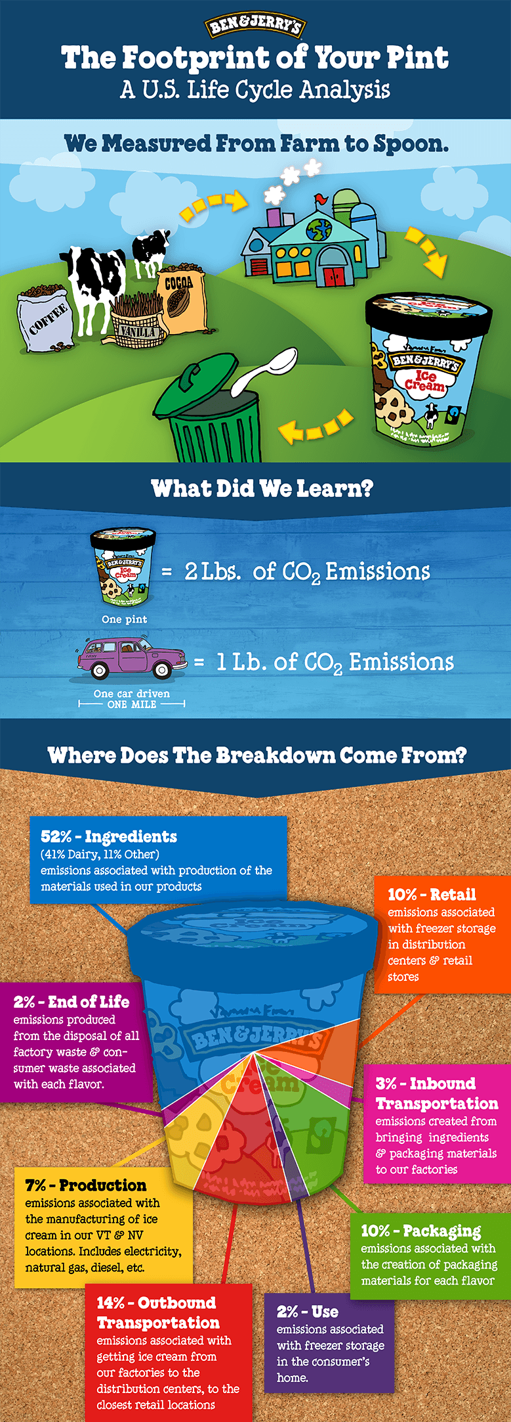
The
Problem
Climate Change
Time is running out
Global warming must stay below 1.5º Celsius to avoid the worst impacts
The economy must transform into a clean energy economy
Every pint of Ben & Jerry’s ice cream produces 2 lbs. of carbon dioxide

Slide 6


Slide 7
The Campaign
Seeks to spread awareness of the climate crisis to consumers, garner support for environmental efforts, and transition its business model into a sustainable one
Initially started in 2007
  Ben & Jerry’s partnered with the Dave Matthews band to create its first global warming advocacy campaign
Ben & Jerry’s has led advocacy campaigns and partnered with environmental organizations to promote sustainable initiatives, events, and issues
  Completing intermittent Life Cycle Analyses (the tracing of carbon emissions within an organization) and investing in sustainable manufacturing equipment
The campaign was initially short-term
  It has since transitioned into a public relations program that has proven to be a long-term commitment for the company

Slide 8
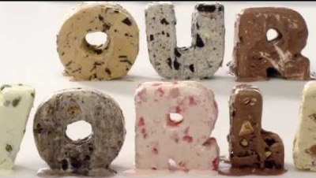

Slide 9
Strategies
Commit to reducing its absolute greenhouse gas footprint
Drive increased efficiencies within the company
  Through its manufacturing plants, logistics network, frozen supply chain and over-the-road refrigerated truck fleets that move products domestically
Develop a greenhouse gas model that will allow measurements of real reductions in the carbon footprint of farms
Search for improvements in product packaging
  When it comes to packaging, all the paperboard in its packaging is made from Forest Stewardship Council certified paperboard. Due to hygiene issues, they are required to coat their FSC paperboard; therefore the packaging is not currently widely recyclable

Slide 10
Tactics
Created specialized ice cream flavors to spread awareness of climate change
Selling more non-dairy ice cream options
  Because cows increase the carbon footprint
Promoted interactive information on its website
  A sign-up form for viewers to receive emails about climate campaigns from Ben & Jerry’s and its partners; Publishes informational blogs on the website every month
Partnered with environmental organizations to promote campaign awareness
Invested in important technologies
  Manure separators and bio-digesters on dairy farms in the supply chain
  Solar array at Waterbury, VT factory that generates one third of that plant’s electricity
  Bio-digester at Hellendoorn factory in the Netherlands that turns ice cream waste from the manufacturing processes into clean energy that helps power the plant
  Helped pioneer technology for climate friendly (i.e. HFC-free) freezer cases

Slide 11
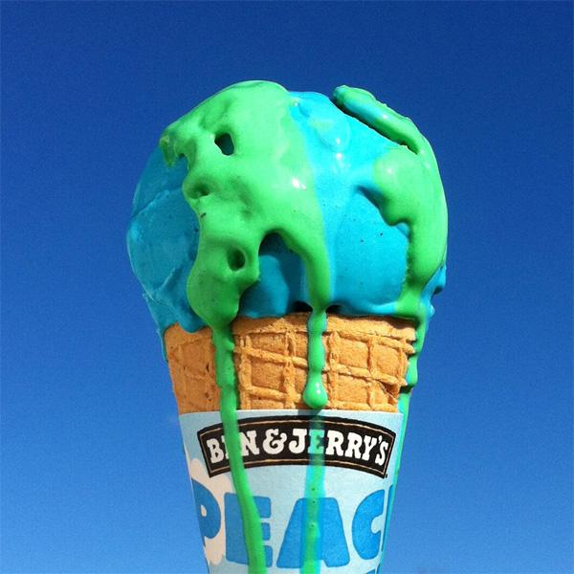
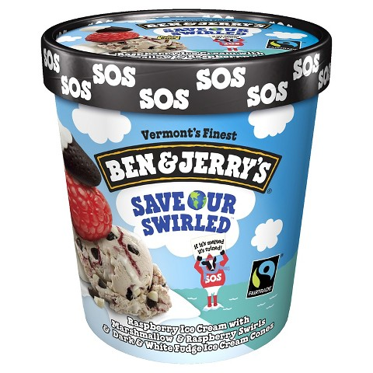
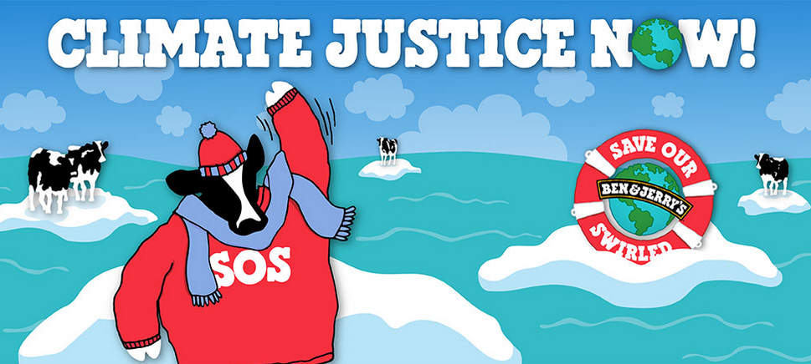
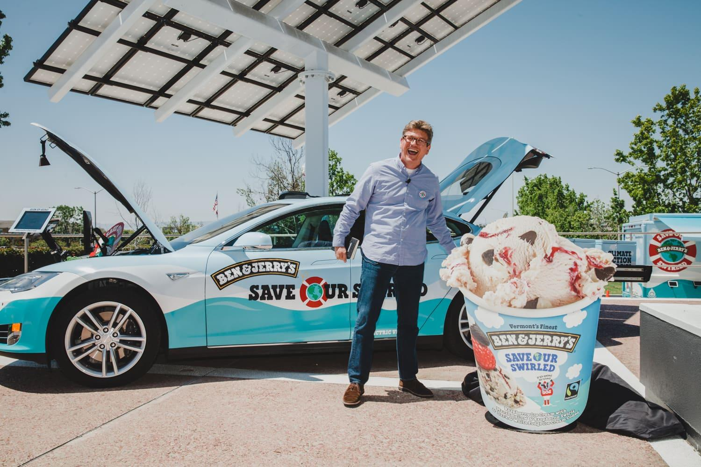
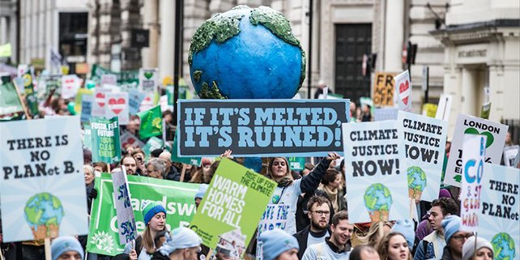

Slide 12
Campaign Partners
Avaaz
A global web movement to bring people-powered politics to decision-making everywhere.
The Climate Reality Project
A nonprofit organization focused on climate change education and clean power advocacy. They encourage citizens to get smart, get loud, and get active to affect change.
350.org
A climate change movement that’s organizing, empowering, and informing citizens in 188 countries to pressure their leaders into addressing climate change and cutting emissions.
Business for Innovative Climate & Energy Policy
An advocacy coalition of businesses committed to working with policy makers to pass meaningful energy and climate legislation.

Slide 13
Results & Evaluation
Results
Evaluation
Gained media attention through unique product placement and ads
  Ice cream flavor and Earth representation
Strengthened the company’s Corporate Social Responsibility (CSR) standing
Promoted global warming awareness through marches, advertisement, and digital technology
Incorporated innovative sustainable technology in its facilities
  Sets the stage for other corporations to follow suite
Difficult to determine measurable results of this long-term public relations program
  This is an issue because Ben & Jerry’s should be able to communicate what it’s doing and how it’s working
Produced an unsustainable product to promote sustainability
Maintaining momentum with progressive ways to address the issue
Provided an easy way for consumers to get involved with the issue

Slide 14
Questions
Question 1
Question 2
Question 3
Question 4
Can Ben & Jerry’s be part of both the solution and the problem of climate change?
Has Ben & Jerry’s strategies and tactics been enough to garner widespread support for fighting climate change? Or, is there more that can be done?
In what ways can Ben & Jerry’s more openly share measurable results of its public relations program with the public?
Can Ben & Jerry’s act as a CSR role model to other corporations? Why or why not?

Slide 15
Resources
https://www.benjerry.com/values/issues-we-care-about/climate-justice
https://en.wikipedia.org/wiki/Ben_%26_Jerry%27s
https://www.forbes.com/sites/annefield/2012/10/22/ben-jerrys-poster-child-for-the-b-corp-movement-becomes-a-b-corp/?sh=db94fc52cc81
https://bcorporation.net
https://www.onegreenplanet.org/environment/ben-jerrys-launches-flavor-to-fight-climate-change/
https://www.vox.com/2018/10/8/17948832/climate-change-global-warming-un-ipcc-report
https://www.benjerry.com/about-us/sear-reports/2015-sear-report
https://www.benjerry.com/about-us

