Slide 1

Exactech on Twitter
Why this social tool matters & how to implement it

Slide 2





Why Twitter?
Engage
with stakeholders and media
Monitor competitors
Gain
valuable industry insights
Build
brand personality and awareness

Slide 3
Competitive Analysis

Slide 4
All of Exactech’s competitors are currently active on Twitter.

Slide 5
What type of content will Exactech Tweet?
News Releases
Professional Events
  Speakers, conferences, etc.
Company Videos
  Informational content, patient testimonials, etc.
Holiday & Celebration Acknowledgements
Internal & External Community Engagement

Slide 6
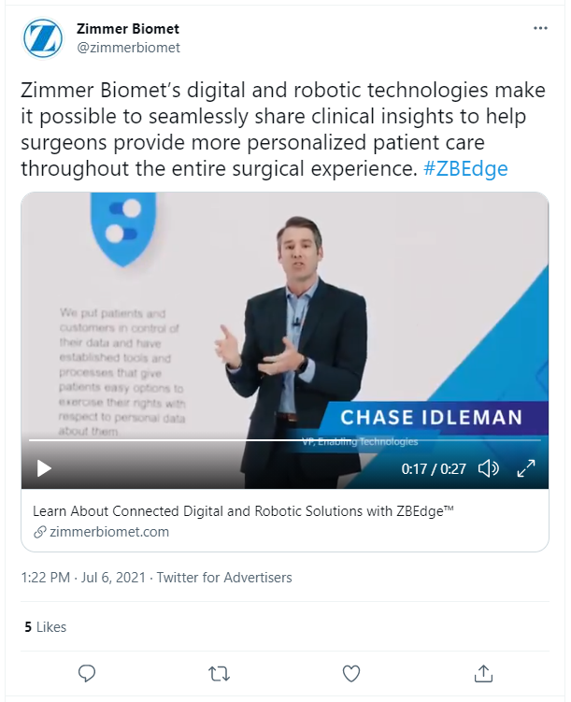
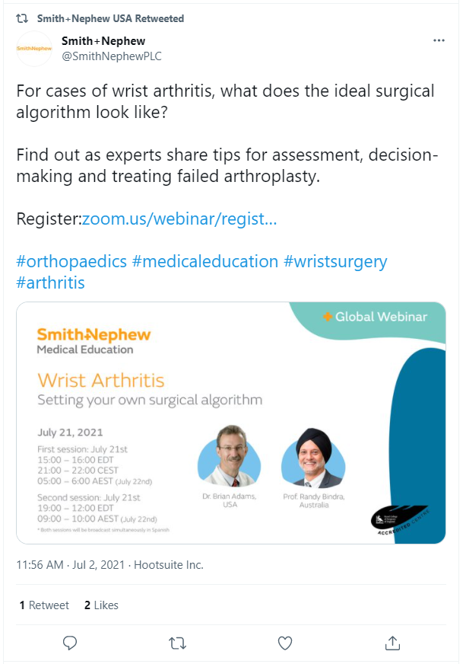
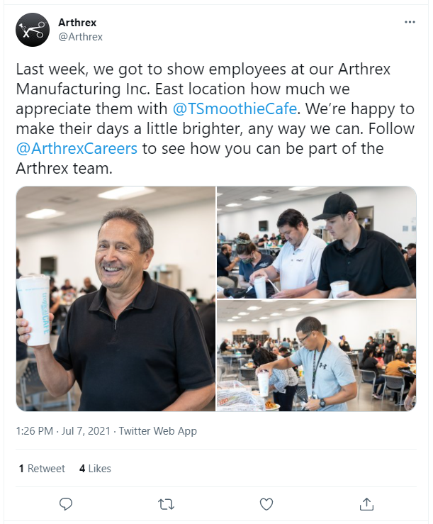
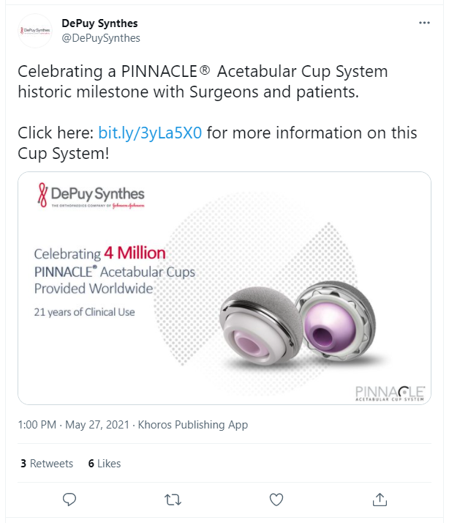
Tweet Examples

Slide 7
Who should Exactech follow?
Surgeons
Global, Industry & Local Media
Competitors
Government & Nongovernment Organizations
  FDA, AAOS, American Red Cross, USDA, trade journals, industry associations, etc.
Company Sponsors & Partners
  UF, The YMCA, PHOS Creative, etc.

Slide 8


Who is Exactech’s audience?
Current & Potential Stakeholders
Media
Local
Industry
Global
Surgeons
Patients
Employees

Slide 9
Hashtags
#ActiveIntelligence
#ShoulderSurgery
#KneeSurgery
#LifeAtExactech
#JointReplacement
#GPS
#Orthopaedics
#Healthcare
#Innovation
#Exactech
#AnkleSurgery
#HipSurgery
#SurgeonFocusedPatientDriven
#ReverseShoulder
#MedicanEducation

Slide 10
What’s next?
Draft a list of accounts to follow
Select an Exactech-unique hashtag to include on all tweets
Pinpoint a Twitter reintroduction date
Designate weekly times to review social feed
  Include LinkedIn & Instagram for review
Maintain consistency in tweet frequency & style
  Shorter version of LinkedIn posts
  Develop a social brand guide if necessary
Notes:
Twitter reintroduction date…before AAOS in September??

